Slide 1

Quick Intro in Coding/Programming in the Classroom
Cameras on please!
University of Ottawa Faculty of Ed, 2021-11-12
Peter Beens
@pbeens | pbeens@gmail.com | https://peter.beens.ca/
http://bit.ly/coding-in-classroom

Slide 2
Waterfall Chat
...the “waterfall” strategy is when the teacher poses a question, and students type their answer in the chat, but they do not submit their answer until the teacher prompts everyone to hit enter at the same time, resulting in a cascade of student answers in the chat. [source]

Slide 3
Waterfall Chat Activity
Type your response in the chat window but do not hit Enter until you are told to!
What divisions and/or subjects are you being qualified to teach?

Slide 4
Waterfall Chat Activity
Type your response in the chat window but do not hit Enter until you are told to!
How experienced would you say you at coding/programming?
(# responses only)
1) What’s coding? 2) A little 3) A fair bit 4) I’m an expert!

Slide 5
Waterfall Chat Activity
Type your response in the chat window but do not hit Enter until you are told to!
Briefly describe your coding experience (e.g., Scratch, Python, Micro:bits, Ozobots, etc.)

Slide 6
What is Programming?
Programming is a way to instruct the computer to perform various tasks.

Slide 7
But What Is a Computer?!!
A computer is an electronic device that manipulates information, or data. It has the ability to store, retrieve, and process data.
[Source]

Slide 8
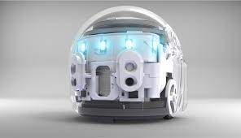
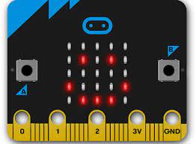

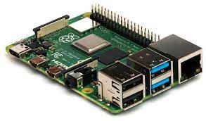
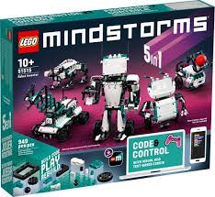

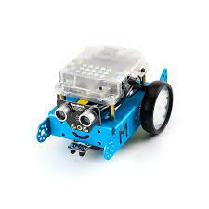

Slide 9
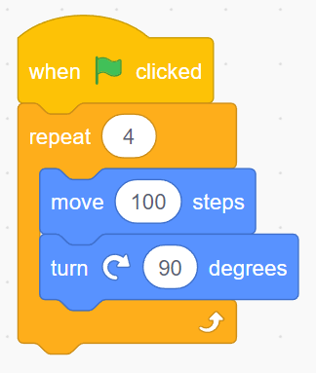
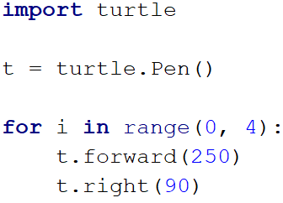
Block-based vs Text-based Programming

Slide 10
Why Is It Important to Learn How to Code?
Programming helps children learn to problem-solve
Computer programming gives kids a challenge and helps them develop resilience
Coding teaches children how to think
A child expands their creativity when they learn how to code
Computer programming is the future
There is a lack of skills in the software industry
Coding helps children learn how to have fun with math
Coding is learning while having fun
[Source]

Slide 11
What Is Computational Thinking?
Computers can be used to help us solve problems. However, before a problem can be tackled, the problem itself and the ways in which it could be solved need to be understood.
Computational thinking allows us to:
take a complex problem,
understand what the problem is and
develop possible solutions.
We can then present these solutions in a way that a computer, a human, or both, can understand.
[Source]

Slide 12
The Four Cornerstones of Computational Thinking
decomposition - breaking down a complex problem or system into smaller, more manageable parts
pattern recognition – looking for similarities among and within problems
abstraction – focusing on the important information only, ignoring irrelevant detail
algorithms - developing a step-by-step solution to the problem, or the rules to follow to solve the problem
Each cornerstone is as important as the others. They are like legs on a table - if one leg is missing, the table will probably collapse. Correctly applying all four techniques will help when programming a computer.
[Source]

Slide 13
My Plea!
Apply the concepts of Computational Thinking to as many of your coding/programming activities as possible.

Slide 14
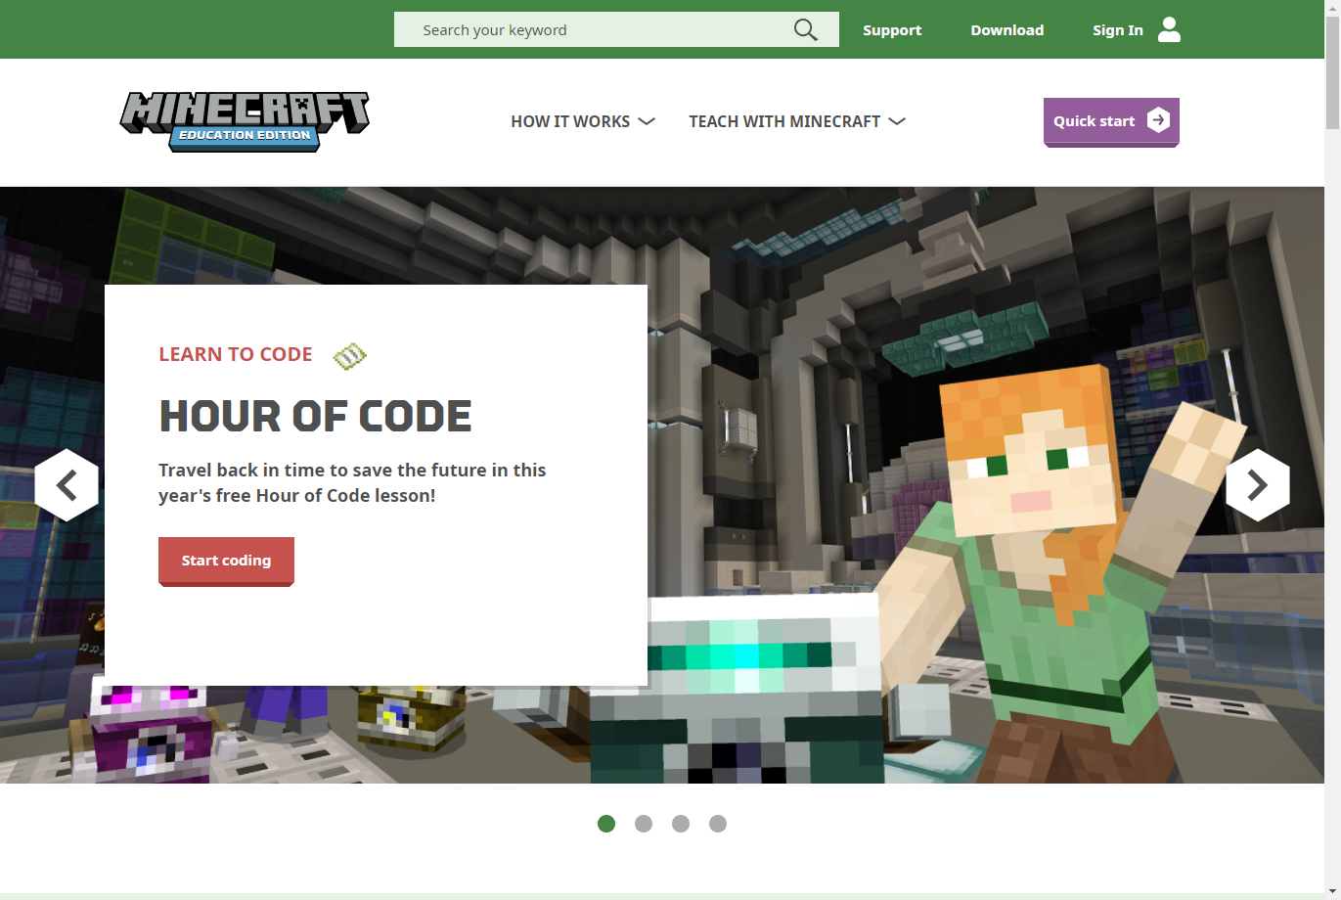
Minecraft Education
https://education.minecraft.net/fr-fr/homepage

Slide 15
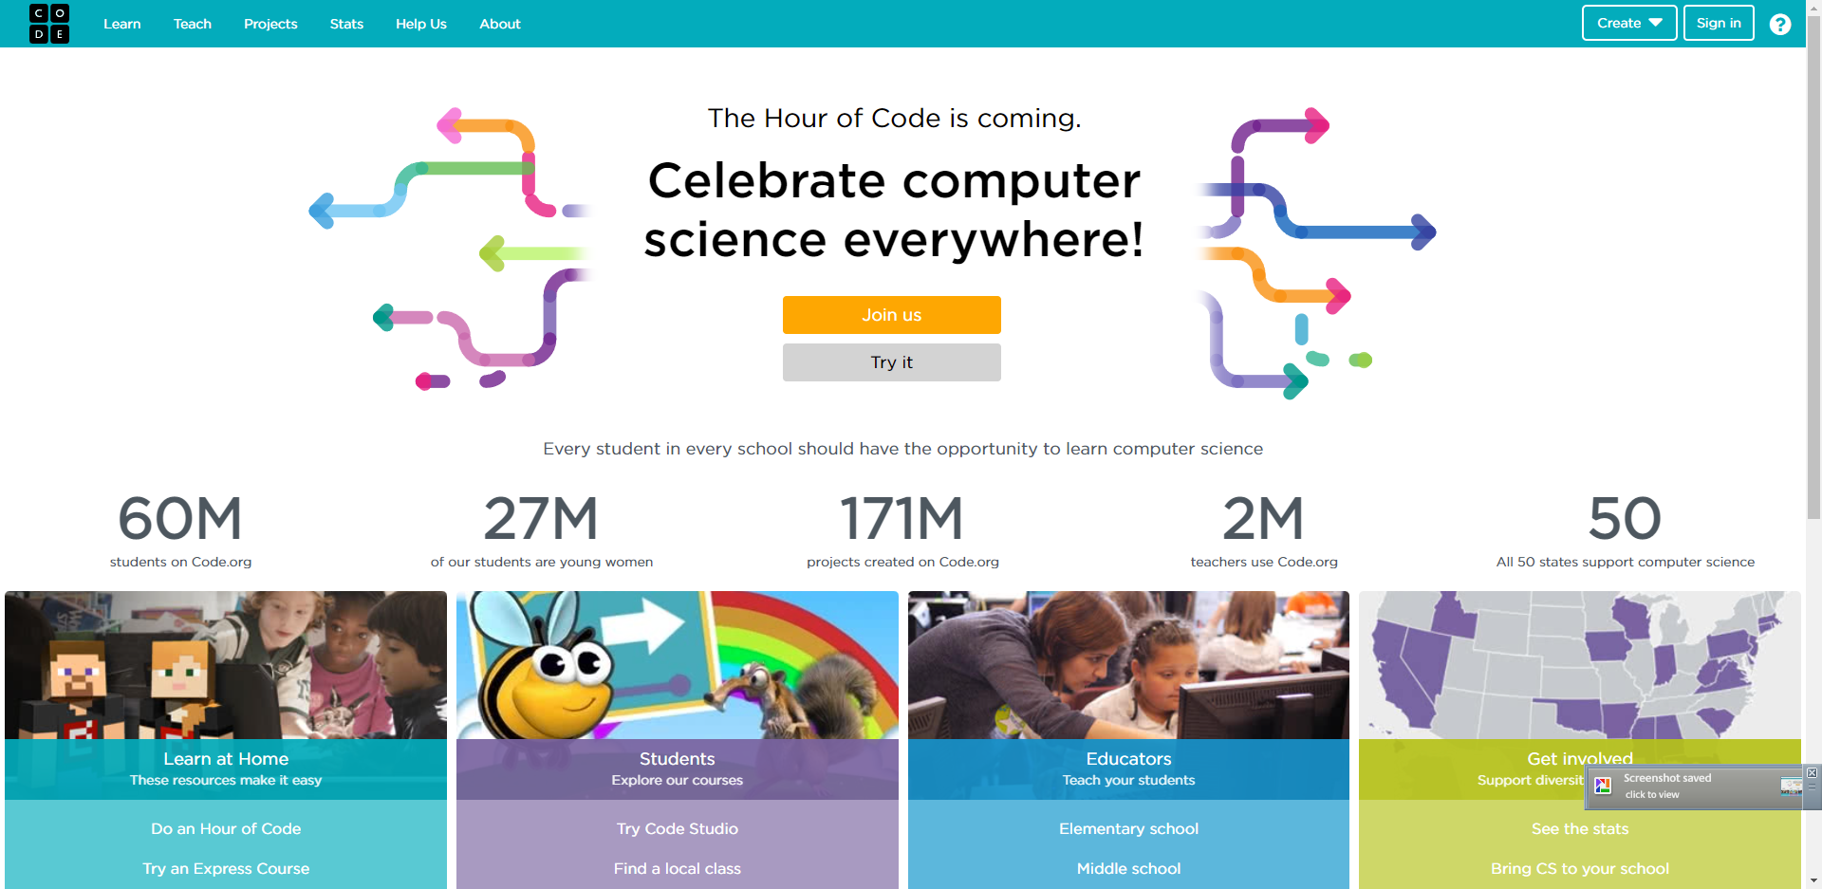
Code.org
https://code.org/

Slide 16
Where to Learn Python?
https://cscircles.cemc.uwaterloo.ca/
http://snakify.org.testednet.com/
https://groklearning.com/hoc/activity/animal-classifier/
https://developers.google.com/edu/python
https://www.py4e.com/
https://www.codecademy.com/learn/learn-python-3/
https://snakify.org/en/

Slide 17
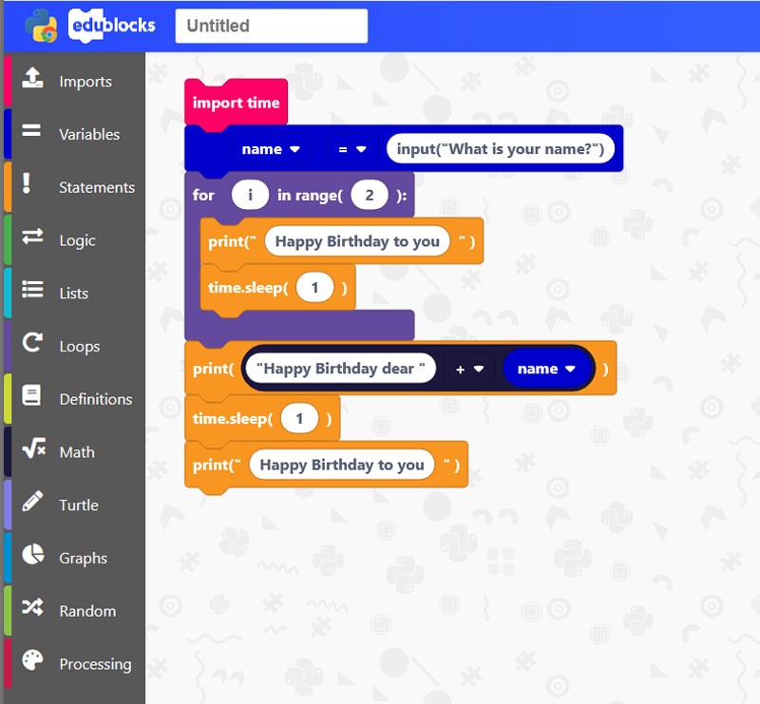
Block-based Python
https://staging.edublocks.org/
[Image Source]

Slide 18
Jupyter Notebook Options
Online:
Callysto | Teacher Starter Kit | Online Courses
Google Colab | Math in Python for Grade 8/9 | Colab for Math Educators (courtesy Karen Spindler)
Jupyter.org
Offline:
Anaconda

Slide 19
Quick Colab Demo
http://bit.ly/math-python-notebook-colab

Slide 20
ACSE Mail List
Association for Computer Studies Educators
https://acse.net/mail-list/

